Slide 2
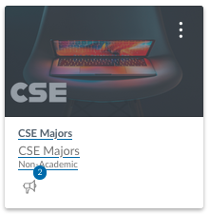
Welcome CSE Department
Upcoming Event:
9/18 BYU Provo Job Fair
9/21 Devotional + Meal
9/25@5:PM Comp. Society Fair
9/27 Date Night
10/3-5 General Conference
10/17 BYU-Idaho Job Fair
10/18-19 BYU Hackathon Oct 18th

Slide 3
Classroom arrangement or as close as we can manage
Floor Edge
Floor Edge
Front of Classroom
Front of Classroom

Slide 4
CSE 300 Professional Readiness
W. Clements

Slide 5
Do you want to know about your Instructor?
YES
NO

Slide 6
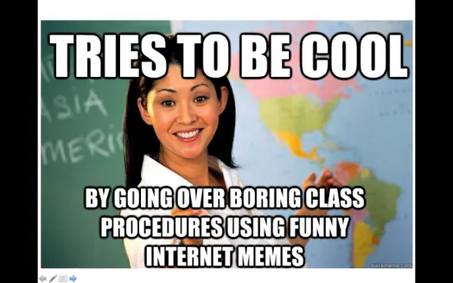
A little about me… Myth: Don’t talk to strangers
20+ Years experience
Masters: Univ of CO @ Denver; Bachlors; BYU-Provo; Associates: Ricks College
Worked for Northrop Grumman (TRW) for 13 years, Raytheon for 5 years
Been teaching for 10+ years: Online, Hybrid, and Campus for Community Colleges of Colorado, BYU-Online, and BYU-Idaho
I love computing, I have since I saw my first for-loop fill the screen with my name.
I have moved over 20x, CA, UT, ID, MO, OK, TX, CO
Hobbies: Board Games, Family outings

Slide 7
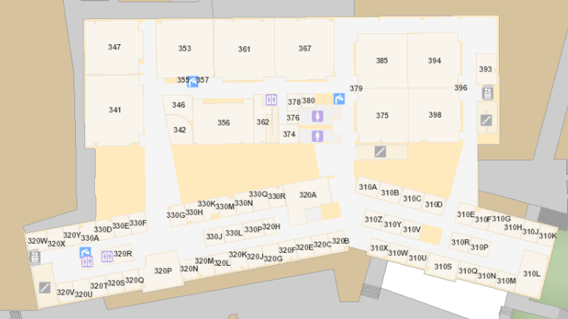
Bro Clements
William Clements
Email: ClementsW@byui.edu
Google Phone: (208) 557-4333
Office Phone: 208-496-7617
Office Rm: 320 T (Mark Twain with a T – Samuel Clemens)

Slide 8
Do you want to know about your classmates?
YES
NO

Slide 9
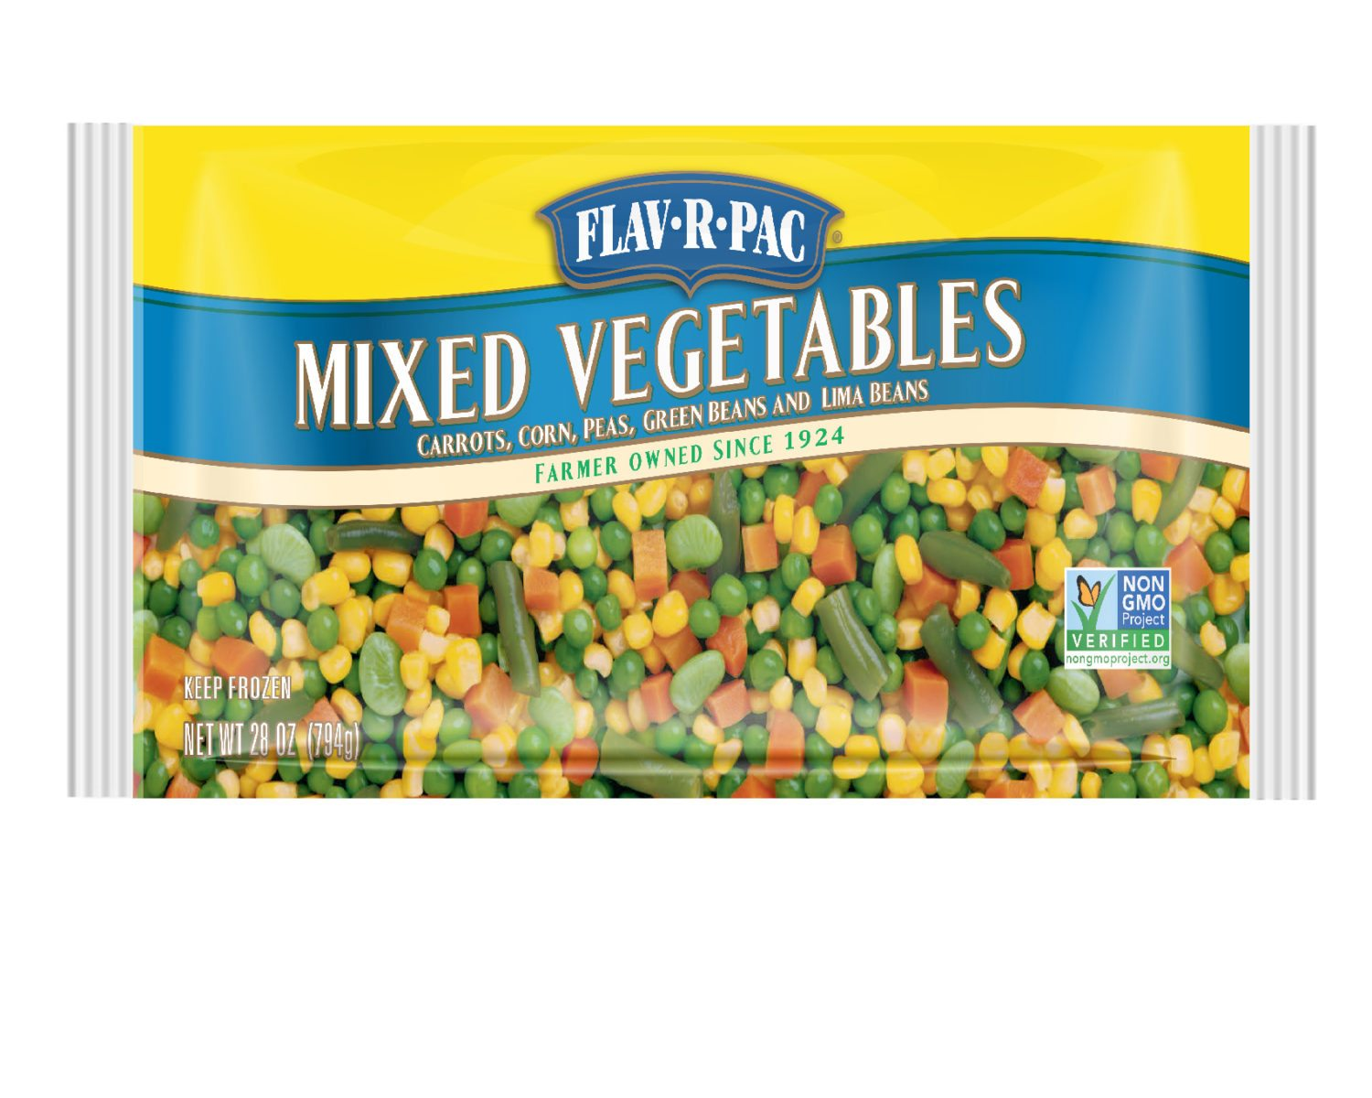
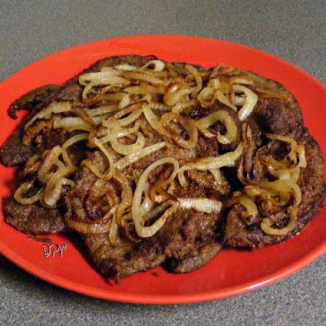
Let’s Debate -Safely
Food: Indian, Tex-mex, Italian, and everything but lima beans and liver and onions.
What food do you like? Why?
What food do you refuse to eat? Why?

Slide 10
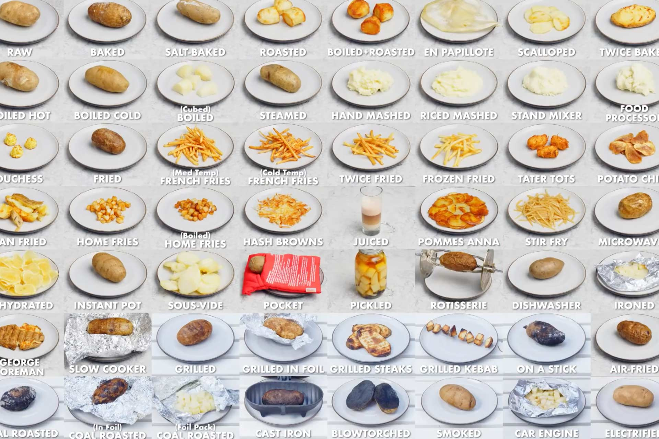
What is your favorite way to eat a potato?
Everyone move to the least amount of tables
Find out
Name, From, Major
Contact Info
Preferred potato permutation
What do you do?
What did you learn from the syllabus?
Questions? Whiteboard
What do you want from this class?
Whiteboard

Slide 11
Do You want to know about what you are going to learn from this class?
YES
NO

Slide 12
Primary Purpose for this Class
Have an Internship job between your Jr and Sr Year +/- a semester
Have a degree related job by the time you graduate.
Maintain employability 5 years from the time you graduate.
Confidence
Connectivity
Employability

Slide 13
Tools to finding a job?

Slide 14


Supplies
Resources
Resume
Interviewing skills
Cover Letter
Online Interviewing
Handshake
Job Boards
Elevator Pitch
LinkedIn

Slide 15
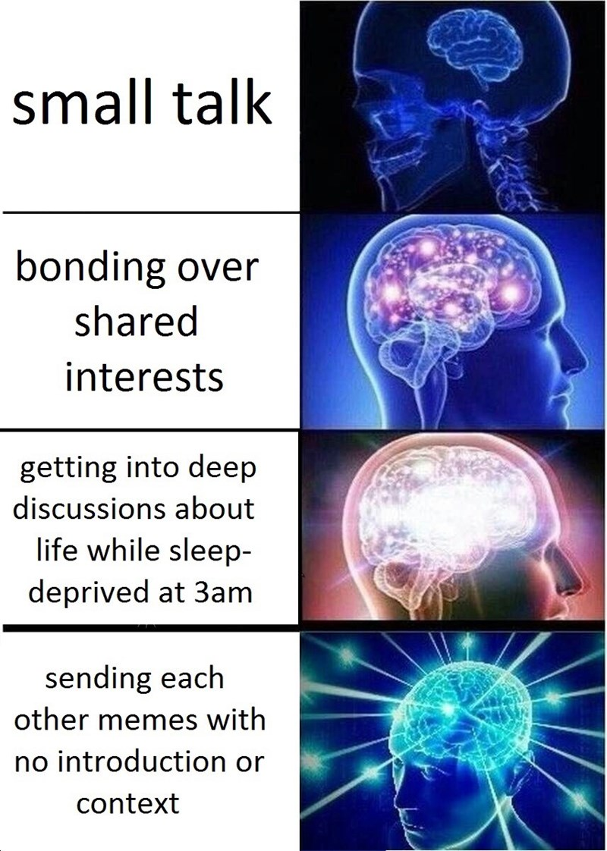
Connection
Confidence
Employer List
iConnect
LinkedIn
Managing Contacts
Computer Society
Posting on LinkedIn
Portfolios
Salary Negotiation

Slide 16
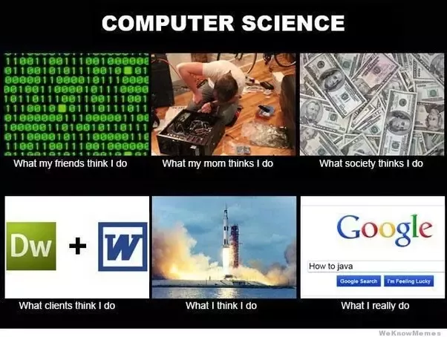
Career Path
Explore
Deliverables
Informational Interviews
Senior Project
Graduate options
Conduct
Devise / Plan
Extending Academics

Slide 17
Do you want to know how to pass this class?
YES
NO

Slide 18
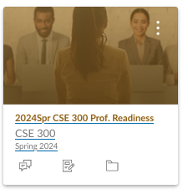
Syllabus
Found in iLearn
Honor Code –
No hats
ChatGPT/LLM/etc
Accessibility
I am flexible, Do the Work - get the grade.
Harassment
a safe and respectful environment
Personal Late Policy
Turn something in – even a note of when you will turn it in.
Learning Class - Resubmissions are allowed
Class Cash
Tuition?
Name Tents
Names are important
Help me, help you, help me.
You get Class Cash for comping to class with Name Tent
Auction every Thursday.

Slide 19

Class Bucks
https://ibelong.byui.edu/home_login
One Class Buck for each activity:
Please have your count ready when I come by.
School Resource:
Arts, Sports/Fitness, Health Srv, Points of Interest
Academic Resources:
Tutoring: Lab or Library: Tuesday, Thursday, Friday 3:30-6:30, STC375/385/394/384, CSE Volunteer Tutor Lab
Department Services
Computing Society: 5:00-5:30, STC375/385/394/384,
Forum: Thurs: 11:30
Experience:
Career Center
Work (every 4 hrs)
Networking & Informational Interviews
Personal Growth
Disciples of Christ: Church, Devo, FHE
Dating, Workshops, Books,

Slide 20
Grade Percentage
Assignments – 60%
Confidence – 20%
Connectivity – 20%
Professionalism -20%
Assessment – 40%
Career Basic and Silver Certficates
Profile reviews
Attendance
If you are not part of the solution, you are part of the problem…
So if you are not present, then …

Slide 21
Assignments
Wk 02: Professional Employability Supplies
Wk 03: Discovering Professional Employability Resources
Wk 04: Get the Word out - Connections
Wk 05: Life-Long learning - Confidence
Wk 06: Explore Your Career Paths
Wk 07-13: Explore Your Career Paths Delivery 1-7 (all + one from each)
Informational Interviews
Sr. Project Preparation
Graduate Possibilities

Slide 22
Professional Readiness What do you want to know?
Develop effective skills relating to building professional connections, confidence, and employability.

Slide 23
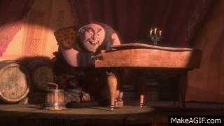
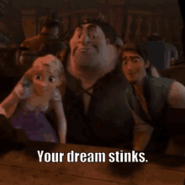
What do you want to do in life?
Begin with the End in Mind
Grave Stone
I’ve got a dream (Dream bigger)
If money was not a problem?
If it was fictious? Impossible?
If time was not a problem?

